Slide 1

PROJECT real TIME cHAT APPLICATION USING TKINTER AND SOCKET
SAMBHRAM INSTITUTE OF TECHNOLOGY ICT aCADEMY
GROUP:14
Bhoomika S
Aaisha Suman
Akshatha A
Suneela R
Dhanyashree L

Slide 2
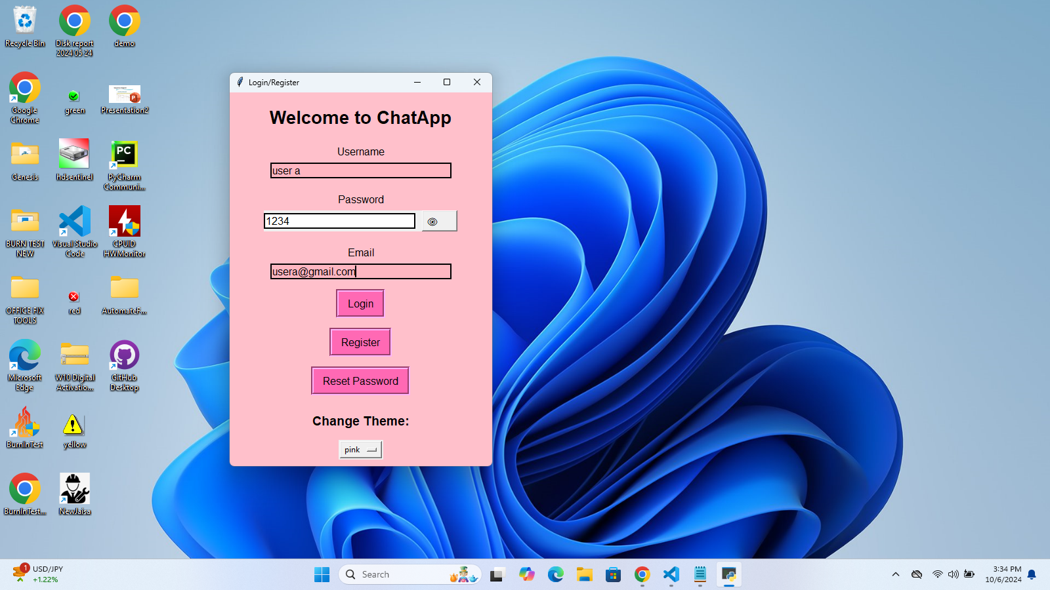
CONTENT
01
02
03
04
05
INTRODUCTION
PROBLEM STATMENT
OUR SOLUTION
TECHNOLOGY USED
MODELING

Slide 3
INTRODUCTION
Introduction to Building a Chat Application Using Tkinter
This is a real-time chat application built using Python, Tkinter for the user interface, and socket programming for network communication.
A chat application allows users to send and receive messages in real-time. With Python, you can build a basic chat interface using Tkinter, a standard Python library used for creating graphical user interfaces (GUIs). Tkinter provides a simple way to design windows, buttons, and other components required to create interactive applications.
It supports multiple users, private messaging, and group chats, with user authentication for secure access.
.

Slide 4
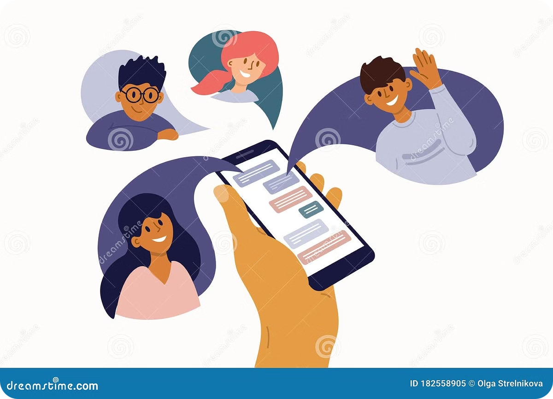
Objective of This Project
Enable Real-Time communication
Secure User Authenication
Facilitate Multi-User Interaction
Simple and user-friendly
Support for private messaging
Reliable and Efficient performace

Slide 5
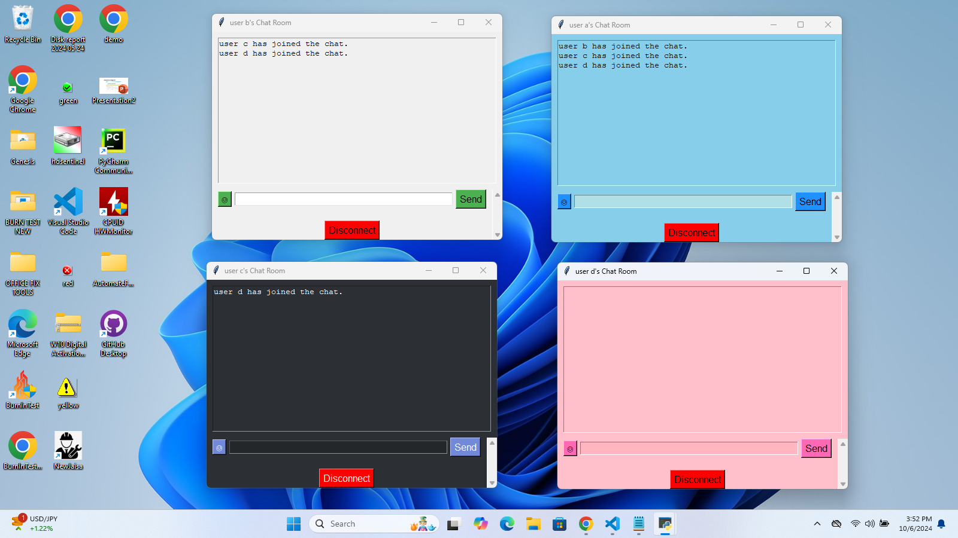
In this project, we will design a simple chat application with the following features:
A window displaying the chat conversation.
An input box for typing messages.
A button to send the typed message to the chat window.
A button to disconnect from the chat window
Also a Button having emojis
This application will simulate a basic chat system where messages typed by the user are displayed in the chat window.
The GUI is interactive, allowing users to send messages by clicking a "Send" button or pressing the "Enter" key.

Slide 6

PROBLEM STATEMENT
Design and implement a real-time, user-friendly chat application that enables communication between multiple users over a network using Python and Tkinter for the user interface, and socket programming for handling network connections. The application should support user authentication, private messaging, and basic chat room functionalities.

Slide 7

Key Concepts
Sockets: Used for communication over the network. The server listens for incoming connections, while clients connect to the server.
Tkinter: A built-in Python library for creating graphical user interfaces (GUIs).
Basic Structure
Server Code:
Create a socket to listen for incoming connections.
Accept connections from clients.
Receive messages and broadcast them to all connected clients.
Client Code:
Create a socket to connect to the server.
Use Tkinter to create a simple user interface with a text box for displaying messages and an entry box for sending messages.
Send messages to the server and receive messages from it.

Slide 8

Implementing the Socket Communication
Socket Creation
1
Establish the foundation of the chat application by creating socket instances on both the client and server sides.
2
Connection Establishment
Implement the necessary steps to connect the client and server sockets, enabling the exchange of data.
Data Transmission
3
Develop the logic to send and receive messages through the socket connection, ensuring reliable and efficient data transfer.

Slide 9

OUR SOLUTION
1
Tkinter Interface
Develop a user-friendly and visually appealing chat interface using the Tkinter Python GUI toolkit.
2
Networking with Sockets
Implement real-time communication between clients using TCP/IP sockets and socket programming in Python.
3
Scalable Architecture
Design a modular and extensible architecture to support growing user bases and future feature additions.

Slide 10

Features of the Application
Real-Time Messaging:
Instant sending and receiving of messages without delay.
Multi-User Support:
Allow multiple users to connect and communicate in the same chat room or across different rooms.
User Authentication:
Enable user login and registration to ensure secure access to the chat.
Usernames and Profiles:
Allow users to set unique usernames .
Emojis :
Enable users to send emojis.

Slide 11
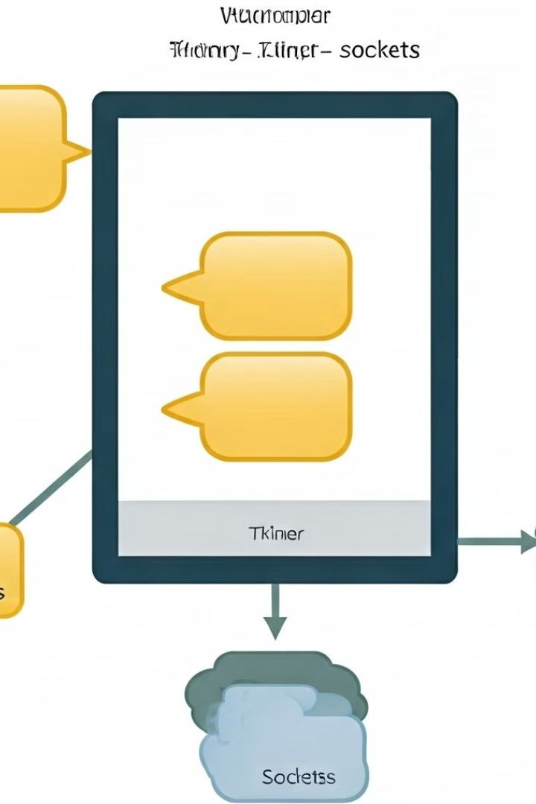




TECHNOLOGY USED
Python
Tkinter
A versatile and powerful programming language, serving as the foundation for the chat application.
A renowned Python GUI toolkit, enabling the creation of an intuitive and visually appealing chat interface.
Sockets
Networking
A fundamental networking technology in Python, facilitating real-time communication between users.
The underlying client-server protocols and networking principles that enable the chat application to function.

Slide 12

What is Tkinter?
Cross-Platform
Flexible and Extensible
Simple and Intuitive
Tkinter is a standard GUI library that comes bundled with Python, making it available on all major operating systems including Windows, macOS, and Linux.
Tkinter offers a comprehensive set of widgets and tools that can be easily customized and extended to meet specific application requirements.
Tkinter has a straightforward and user-friendly syntax, making it an excellent choice for both novice and experienced Python developers.

Slide 13
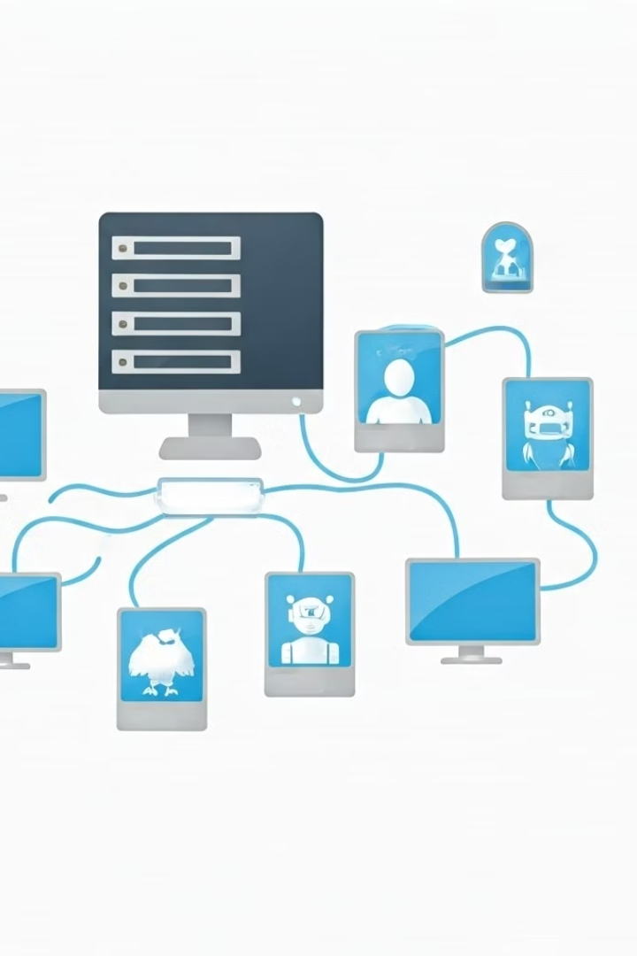
Handling Client-Server Connections
Connection Management
Concurrent Connections
Implement mechanisms to handle the establishment, maintenance, and termination of client-server connections, ensuring the stability of the chat application.
Develop strategies to support multiple concurrent client connections, allowing for seamless group chat functionality.
Connection Notifications
Connection Security
Provide visual cues and updates to users about the connection status, such as when a new client joins or a connection is lost.
Implement measures to ensure the security and privacy of the chat application, protecting user data and preventing unauthorized access.

Slide 14
1. User Management (Registration, Login, Password Reset)
- Registration: A user can register by providing a username, password, and email. If the username already exists or any field is missing, an error message is displayed. Otherwise, the user's information is stored.
- Login: When logging in, the entered username and password are checked against the stored data. If the credentials are correct, the chat window opens; otherwise, appropriate error messages are shown.
- Password Reset: The user can request a password reset by entering their email, receiving a reset code, and then entering a new password.
2. Socket-Based Communication
- Message Sending: Users can send messages through a text entry field. Messages are sent to the server and received back by other clients.
- Private Messaging: Users can send private messages
- Threading: Messages are received in a separate thread (`receive_messages`) to keep the GUI responsive while communicating with the server.

Slide 15
3. Graphical User Interface (Tkinter)
- Login Window: The first window allows users to log in or register, with input fields for username, password, and email. There are buttons for logging in, registering, resetting the password, and changing the theme.
- Chat Window: After logging in, the user is taken to a chat window where they can send and receive messages. This window also includes:
- A chat box (Tkinter Text widget) to display chat messages.
- A scrollbar for navigation within the chat box.
- A message entry field where users can type their messages.
- A send button send messages.
- An emoji picker where users can select emojis and insert them into the message field.
4. Theming Options
- The application supports multiple themes (light, dark, and blue).
5. Emoji Support
- The application features an emoji picker, allowing users to insert emojis into their chat messages. The emoji picker opens a new window with buttons representing different emojis.

Slide 16
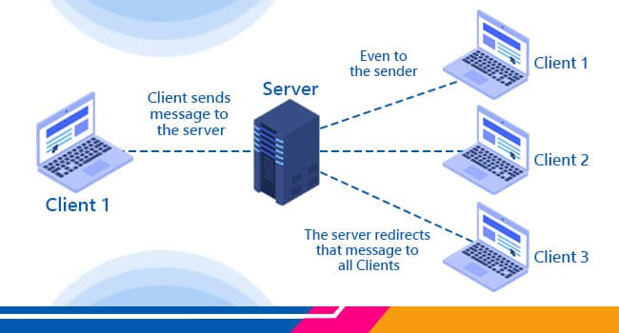
MODELING
HOW THE MESSAGE IS RECEIVED

Slide 17
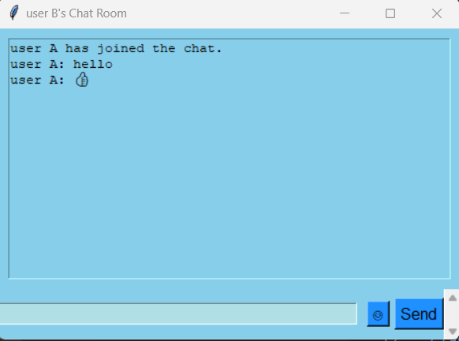
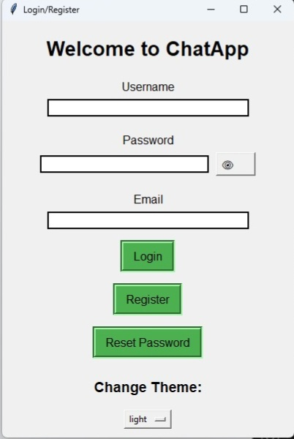
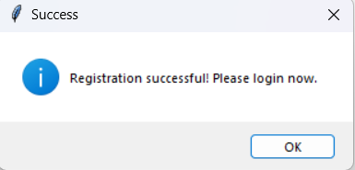
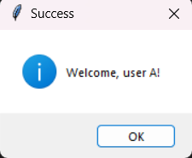
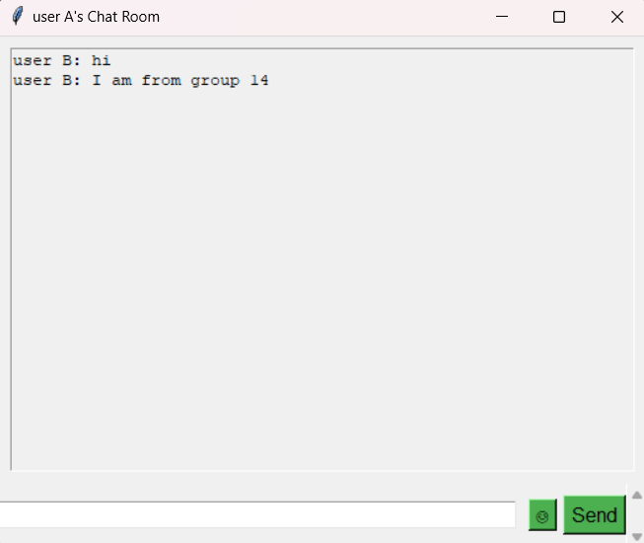
CHAT APP FLOW

Slide 18
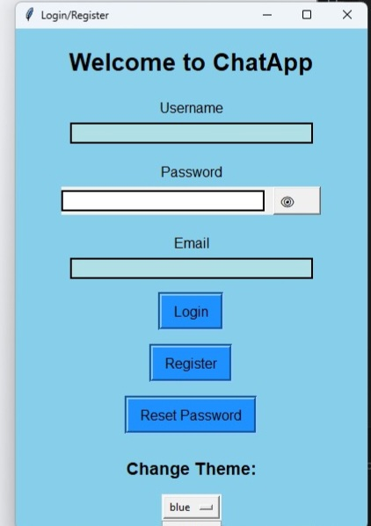
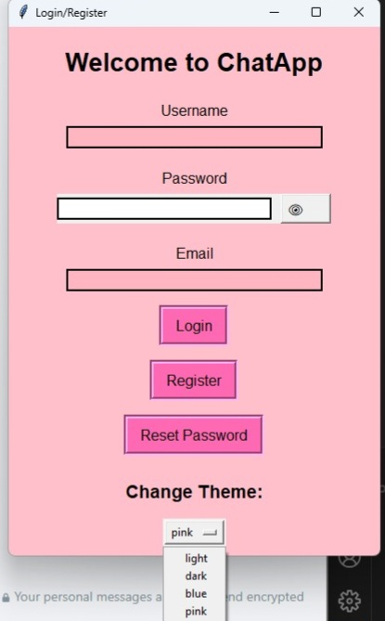
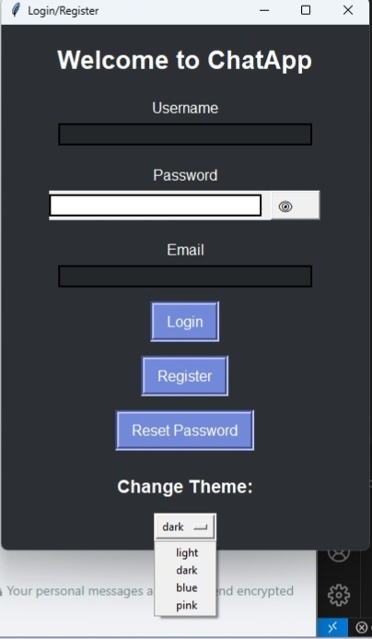
THEME PARK
MAKE YOUR OWN THEME

Slide 19
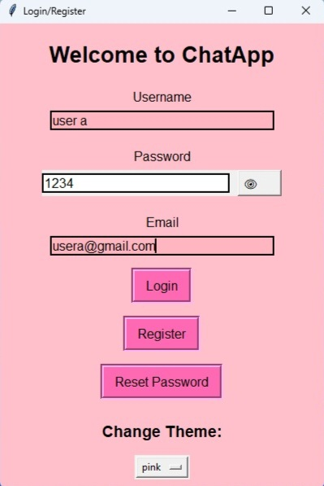
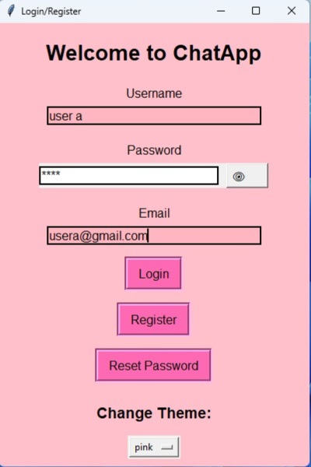
TOGGLE_PASSWORD_VISIBILITY

Slide 20


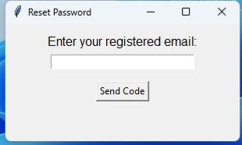
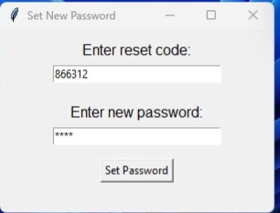
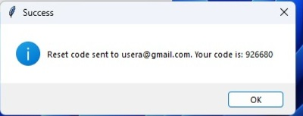

Slide 21
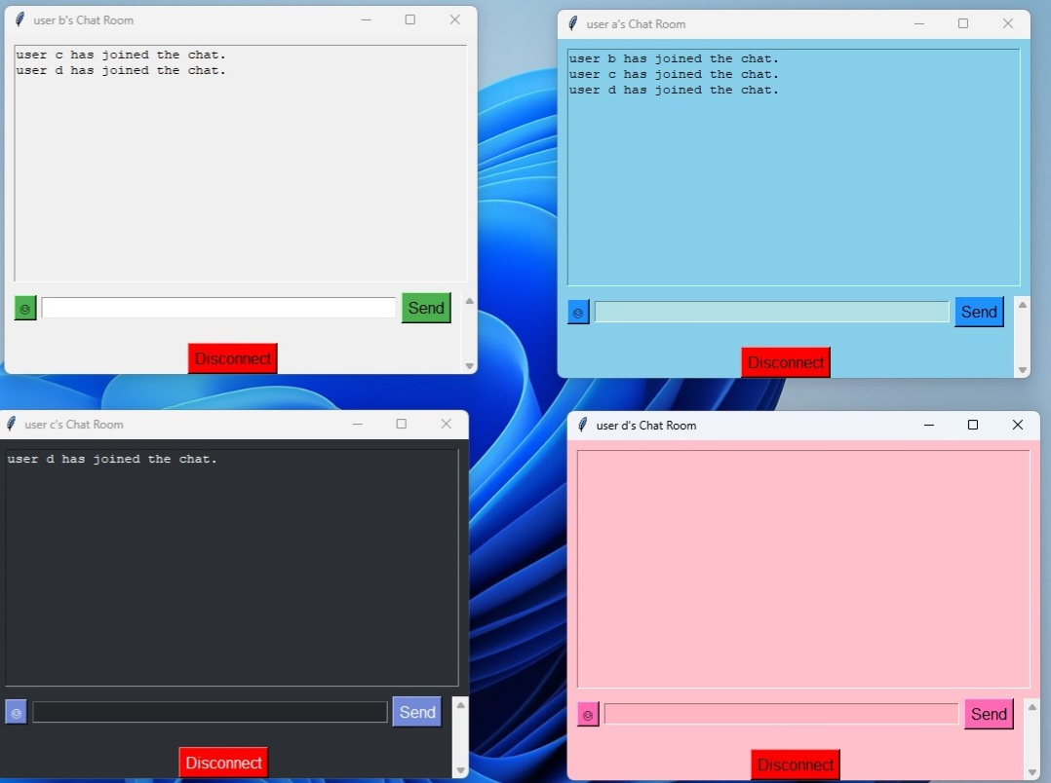
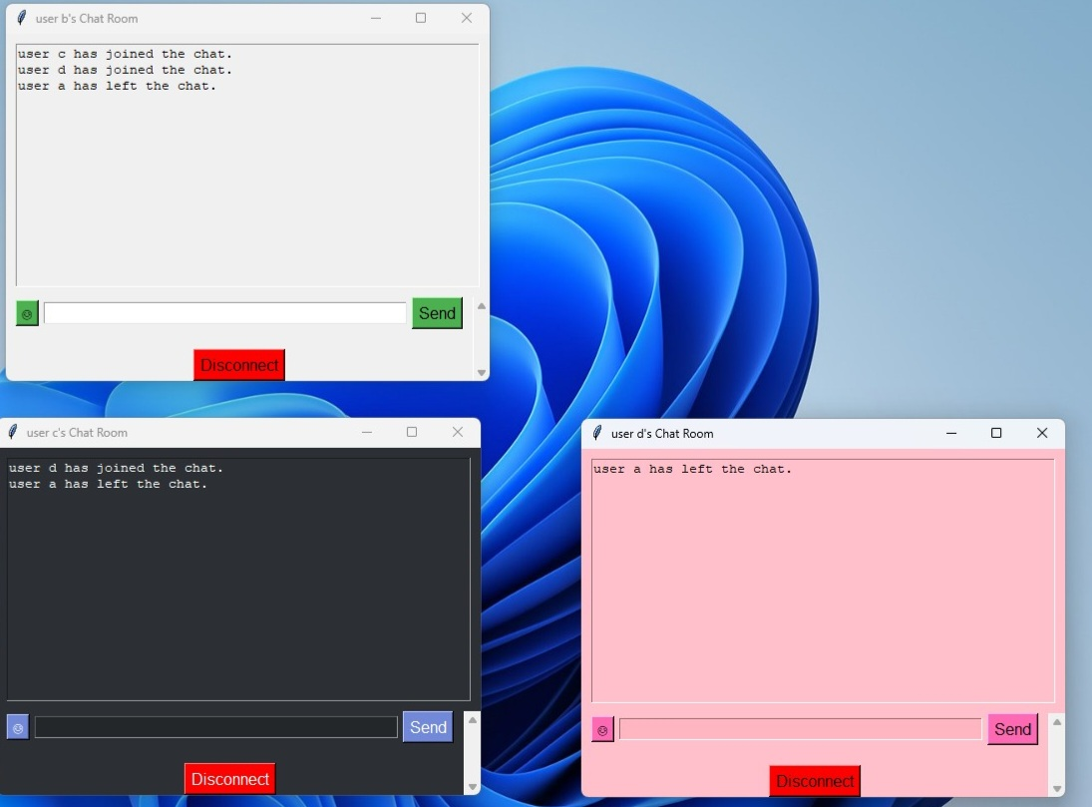
GROUP CHAT USER LEAVE THIS CONVERSATION

Slide 22
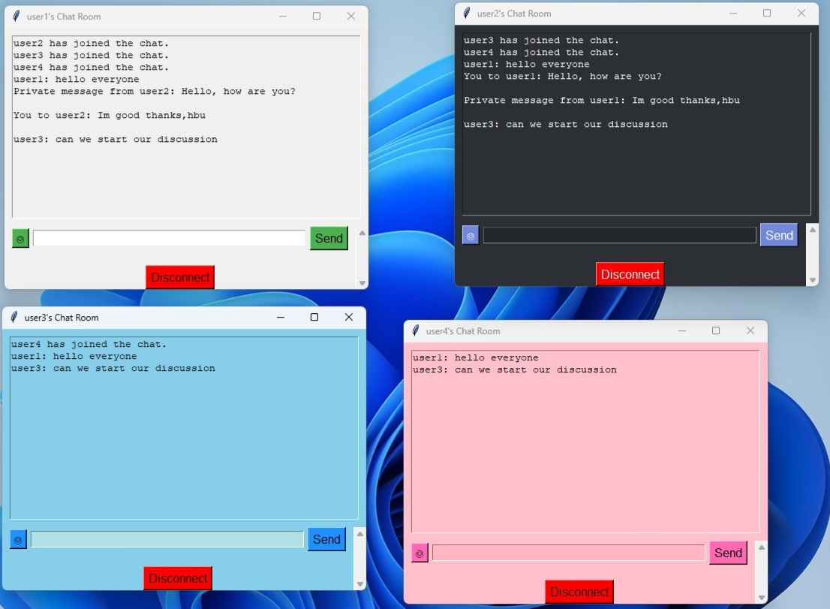
IN GROUP CHAT REPLY PRIVATELY

Slide 23
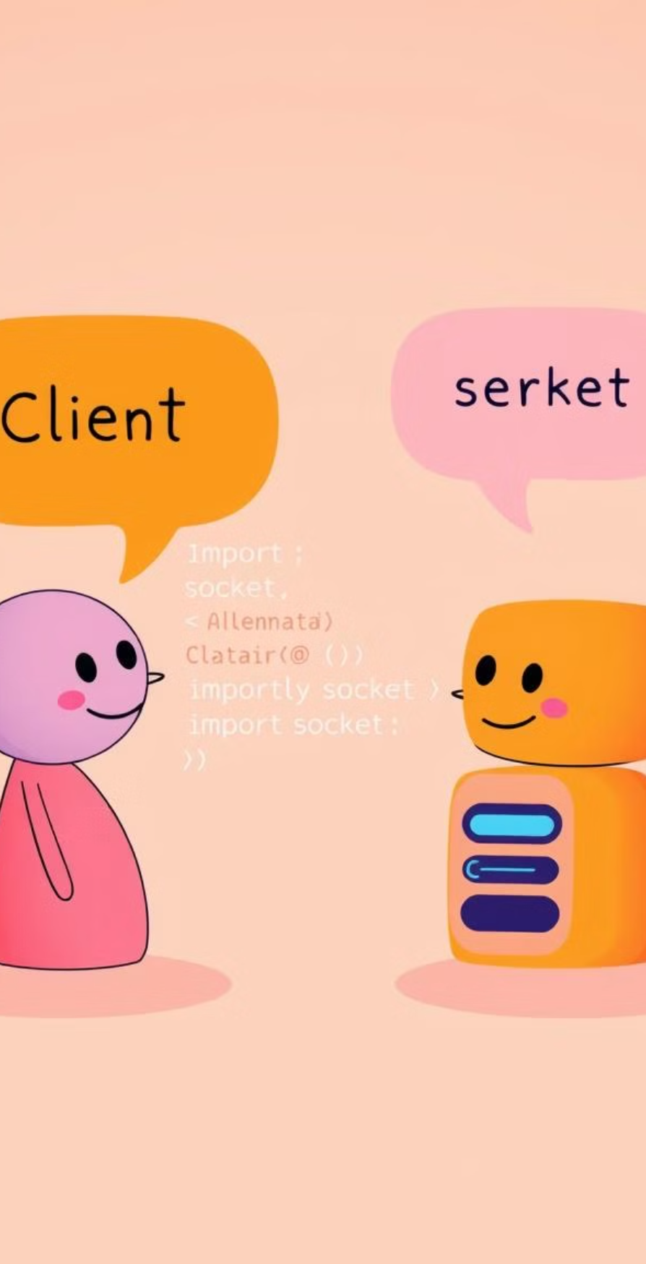
Conclusion and Future Enhancements
1
Key Takeaways
2
Future Improvements
We focused on enhancing the interface by adding theme options (light, dark, and pink), a theme change dropdown, and improving overall user experience with features like the 'Enter' key for sending messages and password visibility toggling.
Adding end-to-end encryption for secure messaging, media sharing (images and videos), We can also introduce profile customization with avatars, and chat history retrieval with search capabilities. Additional features like voice and video calls, message reactions, and file transfer progress bars would enhance user experience. Improving the UI/UX to match modern design trends is also a key focus for future updates
3
Summary
In summary, this chat application allows real-time communication with secure login, private messaging, and group chat functionalities, making it a versatile tool for online communication

Slide 24
THANK YOU

